Slide 1

FIN7053 – Algorithmic Trading Final Project Benjamin Tallman
Spring 2026
Professor Mehmet Saglam

Slide 2
Momentum-Driven Capital Preservation Portfolio
Capturing equity returns with systematic downside protection

Slide 3

The Gap to Fill
Investors within 10 years of expected retirement may still want equity exposure in a portion of their portfolio.
The timespan within 10 years of retirement presents a risk consideration where investors will want draw-down protection
Business and market cycles may be cyclical, but the timing of those cycles is unpredictable.
Cautious investors need systematic risk reduction coupled with safe equity exposure.

Slide 4
The Proposal
A large-cap portfolio designed for reduced volatility
Application of a momentum strategy
Addition of a VIX circuit breaker for capital preservation

Slide 5
Universe & Selection
Top 20 S&P 500 stocks by market capitalization
Further screened to top 10 by 4-month momentum score
Minimum variance optimized 2% floor, 25% cap per position
VIX Circuit Breaker
Daily VIX monitor: trigger at 23, re-entry at 18
VIX ≥ 23 = 100% rotation to BIL (SPDR 1-3 Month T-Bill ETF)
VIX < 18 = rebuild momentum portfolio

Slide 6
Trading Signal and Market Inefficiency
Inefficiency being exploited: Momentum anomaly when markets underreact to information, causing winners to keep winning over 3-12 month horizons (Jegadeesh & Titman 1993)
Signal: 4-month price momentum
Universe: Top 20 S&P 500 by market cap largest, most liquid names
Selection: Top 10 by momentum score from that universe

Slide 7
Signal Generation Process
Pull top 20 S&P 500 by market cap
Calculate momentum score for each at every biweekly rebalance date
Rank by score, select top 10
Feed into CVXPY minimum variance optimizer
Momentum Score = (P[t-10] / P[t-90]) - 1
CVXPY Optimizer Function Used: objective = cp.Minimize(cp.quad_form(w, cov_matrix))
constraints = [cp.sum(w) == 1, w >= 0.02, w <= 0.25]

Slide 8
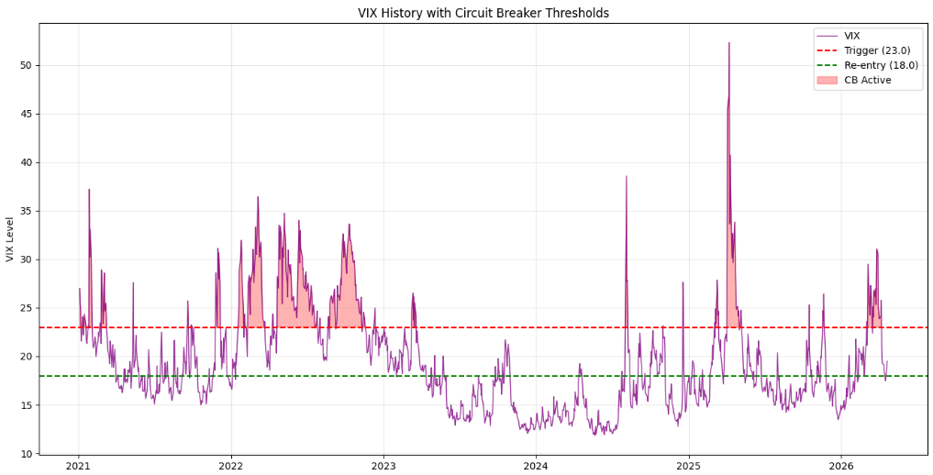
Trading Rules and VIX Circuit Breaker
Entry Rule: Buy top 10 momentum stocks at biweekly rebalance when VIX < 18
Exit Rule: Full liquidation to BIL when VIX ≥ 23
Re-entry rule: Rebuild momentum portfolio when VIX < 18
Rebalance rule: Every 14 calendar days re-run momentum screen, reoptimize, trade delta
Drift rule: Only trade if position drifts more than 2% from target

Slide 9
Risk Management Framework
Volatility control: CVXPY minimum variance optimizer limits portfolio variance
Concentration Limit: 25% maximum per position
Diversification floor: 2% minimum per position — always 10 names held
Macro overlay: VIX circuit breaker removes all equity exposure during fear spikes
Safe haven: BIL SPDR 1-3 month T-bills, near-zero duration, near-zero credit risk
Transaction costs: 5 bps per trade modeled
Execution: Alpaca Markets paper trading API, market orders, DAY time-in-force
Data: Alpaca IEX for prices and execution, yfinance for VIX (Alpaca did not carry VIX index data)

Slide 10
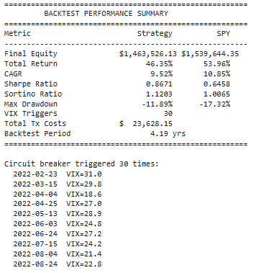
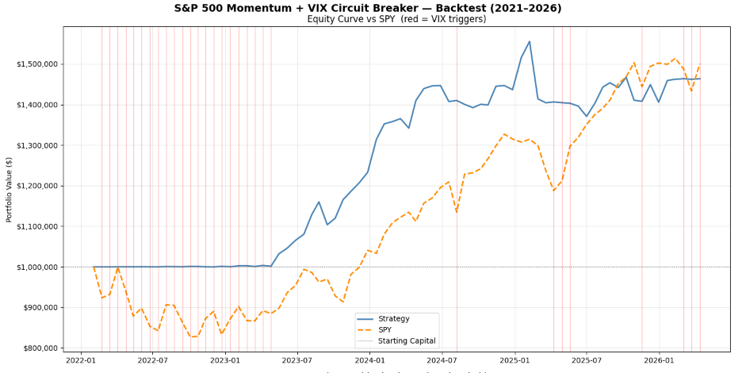
Backtest Results
For a defensive capital preservation portfolio, the model achieved a 46.33% total return (9.51% CAGR) compared
to the SPY total return of 55.31% (11.08% CAGR) for the same 4.2 year testing period. Notably, the model had a
Sharpe ratio of 0.867 (SPY 0.646), and the maximum drawdown was reduced to -11.89% compared to -17.32% for SPY.

Slide 11
Model Refinement and Potential Bias
Several versions of trial-and-error were used to achieve the optimal VIX signals.
Results of previous attempts:
* The maximum drawdown converged at V2 and V3, but the VIX still impacted return percentage.
Version | VIX Trigger/ Re-entry | Sharpe | Max DD | CAGR
V1 | 25/20 | 0.479 | -12.76% | 6.59%
V2 | 27/22 | 0.807 | -11.89% | 9.08%
V3 | 23/18 | 0.867 | -11.89% | 9.51%
Bias: There is a potential survivorship bias due to the selection of the universe of stocks chosen in April 2026. The large-cap selection process and momentum screening offer potential mitigation
Capacity: Since the strategy relies on large cap stocks with momentum, the strategy scales to institutional levels of assets under management without meaningful market impact.

Slide 12
GitHub Repository
https://github.com/benjamin-tallman/Capital-Preservation-VIX-Circuit-Breaker
References:
Fama-French Momentum Factor: Fama, E. F., & French, K. R. (1996). Multifactor explanations of asset pricing anomalies. Journal of Finance, 51(1), 55–84. https://doi.org/10.1111/j.1540-6261.1996.tb05202.x
JEGADEESH, N. and TITMAN, S. (1993), Returns to Buying Winners and Selling Losers: Implications for Stock Market Efficiency. The Journal of Finance, 48: 65-91. https://doi-org.uc.idm.oclc.org/10.1111/j.1540-6261.1993.tb04702.x

